Slide 1
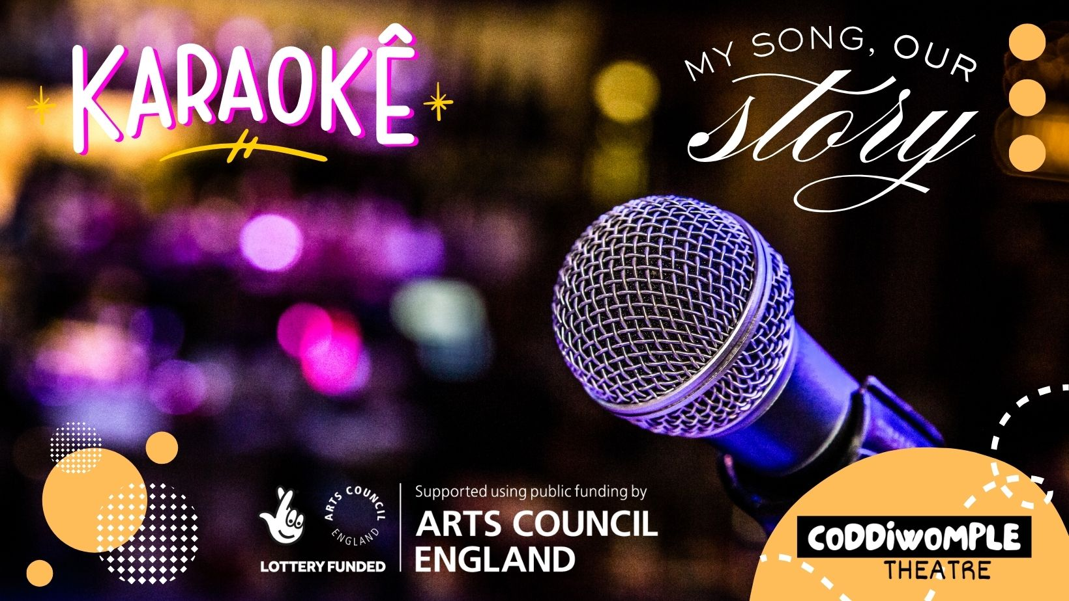
QUIZ
PART-1

Slide 2

Question-1
GENERAL KNOWLEDGE CLUE:
This song is by a Las Vegas rock band and has spent hundreds of weeks on the UK charts. It is often called Britain's unofficial karaoke anthem.

Slide 3
Question-1
LYRIC CLUE:
"Coming out of my cage and I've been doing just fine..."

Slide 4
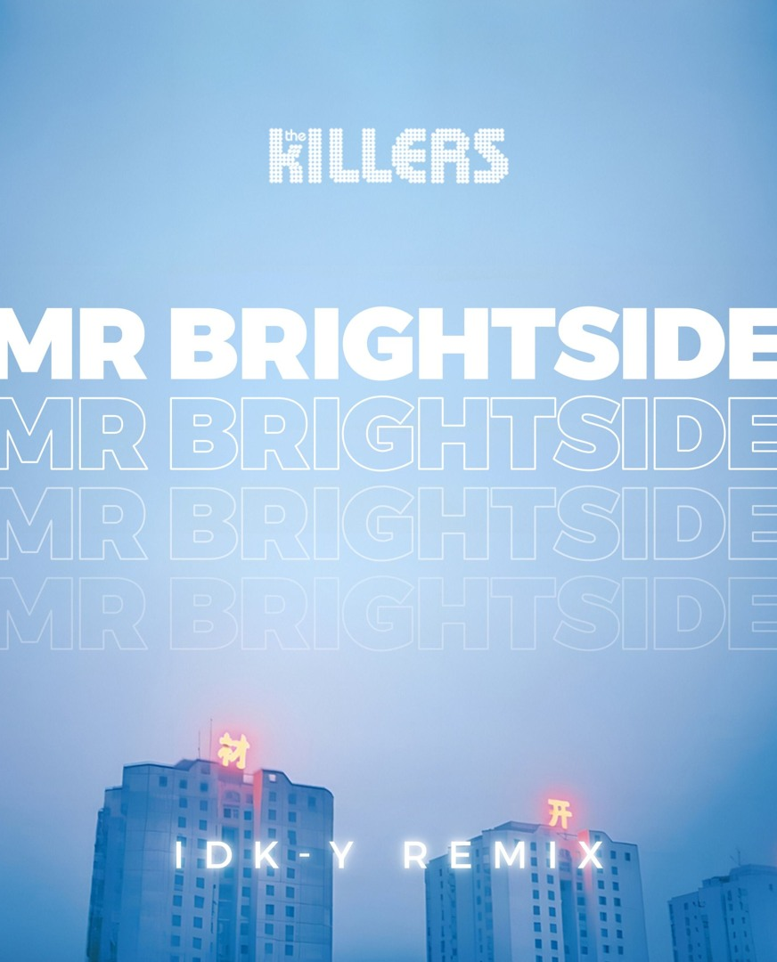
Answer
Mr Brightside
THE KILLERS

Slide 5
Question-2
GENERAL KNOWLEDGE CLUE:
This Swedish pop classic was released in 1976 and is one of the most sung karaoke songs worldwide.

Slide 6
Question-2
LYRIC CLUE:
"You can dance, you can jive..."

Slide 7
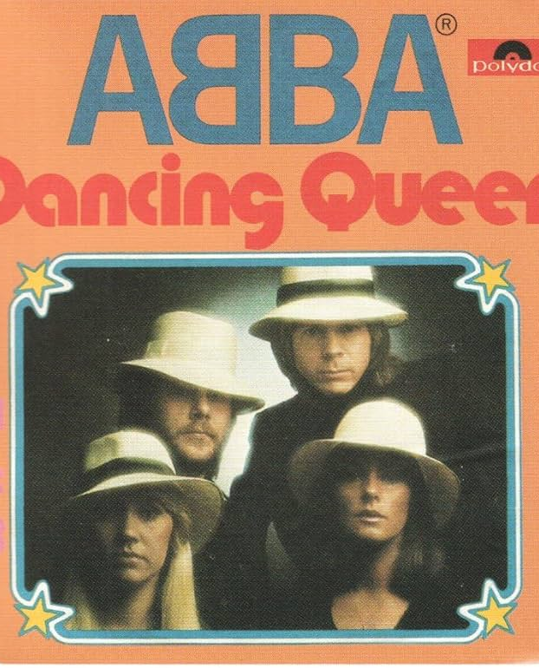
Answer
Dancing Queen
ABBA

Slide 8
Question-3
GENERAL KNOWLEDGE CLUE:
Originally recorded by The Zutons, but a different version became a huge hit thanks to a collaboration between a producer and a singer from North London.

Slide 9
Question-3
LYRIC CLUE:
”Why don’t you come on over …”

Slide 10
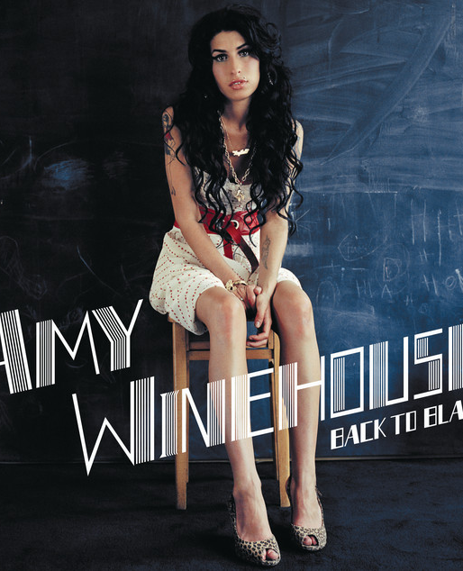
Answer
Valerie
Mark Ronson ft. Amy Winehouse

Slide 11
Question-4
GENERAL KNOWLEDGE CLUE:
This six-minute rock epic includes an operatic middle section.

Slide 12
Question-4
LYRIC CLUE:
”Is this the real life? Is this just fantasy?”

Slide 13
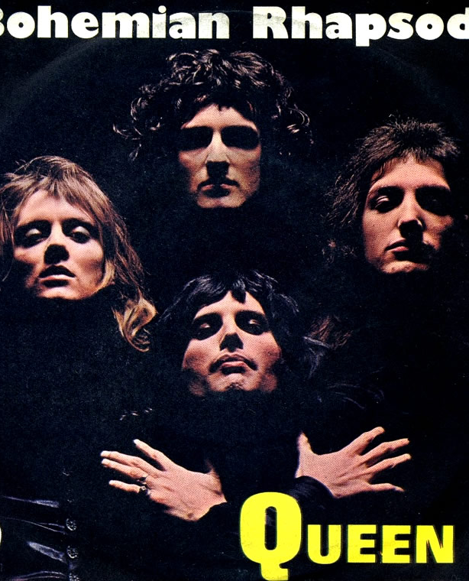
Answer
Bohemian Rhapsody
QUEEN

Slide 14
Question-5
GENERAL KNOWLEDGE CLUE:
Crowds famously shout "BA BA BAA!" during this song.

Slide 15
Question-5
LYRIC CLUE:
"Good times never seemed so good..."

Slide 16
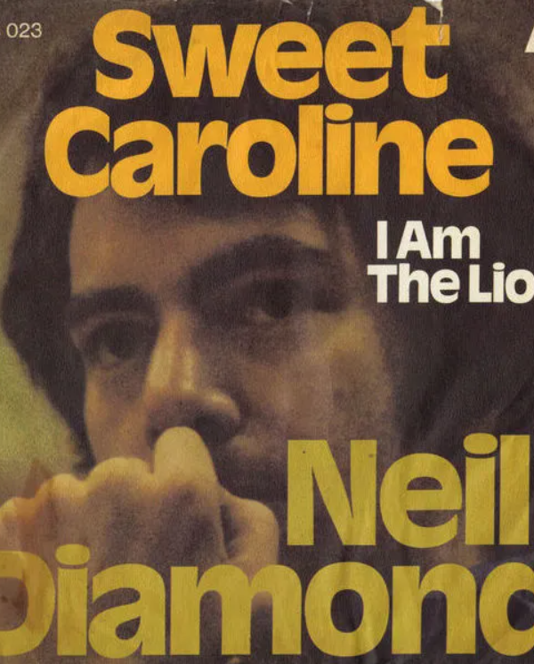
Answer
Sweet Caroline
NEIL DIAMOND

Slide 17
Question-6
GENERAL KNOWLEDGE CLUE:
This Britpop anthem is probably the most requested guitar song in UK pubs.

Slide 18
Question-6
LYRIC CLUE:
"Today is gonna be the day..."

Slide 19
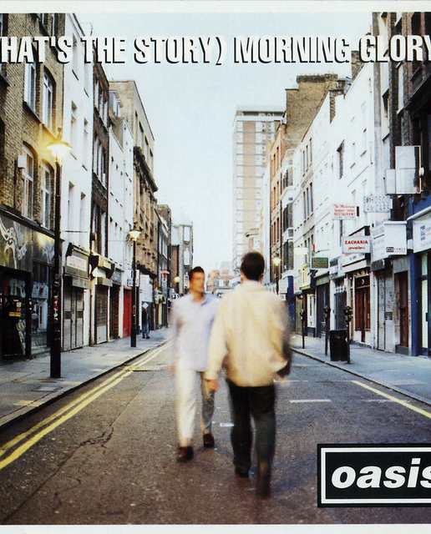
Answer
Wonderwall
OASIS

Slide 20
Question-7
GENERAL KNOWLEDGE CLUE:
This hit asks a question that everyone with a nine to five job instantly answers.

Slide 21
Question-7
LYRIC CLUE:
"Tell me why…”

Slide 22
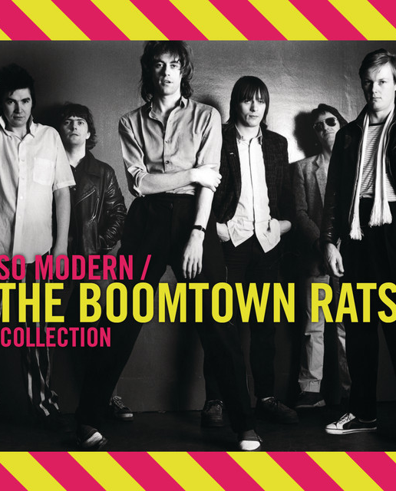
Answer
I Don’t Like Mondays
BOOMTOWN RATS

Slide 23
Question-8
GENERAL KNOWLEDGE CLUE:
Freddie Mercury described this high-energy song as celebrating life.

Slide 24
Question-8
LYRIC CLUE:
"Tonight I'm gonna have myself a real good time..."

Slide 25
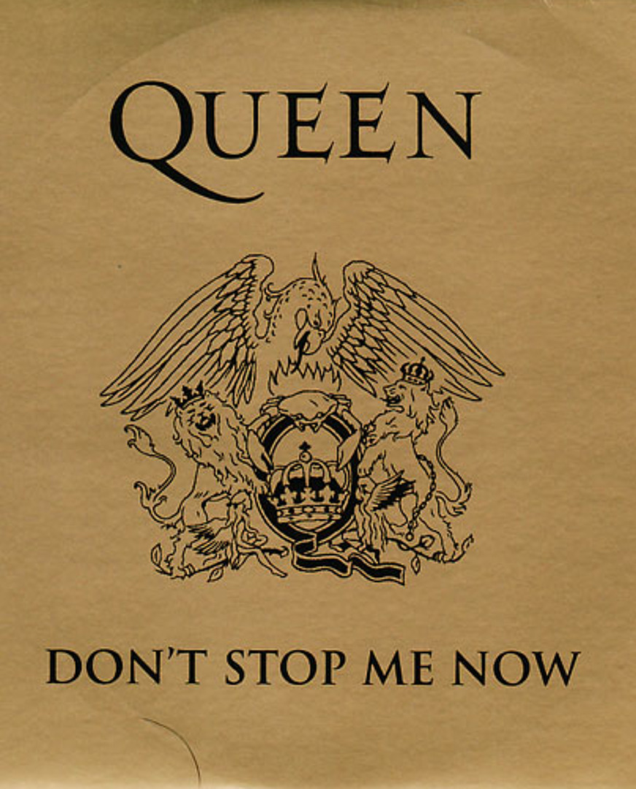
Answer
Don’t Stop Me Now
QUEEN

Slide 26
Question-9
GENERAL KNOWLEDGE CLUE:
A karaoke favourite from 1981 is often sung by people who don't know all the words but love the chorus.

Slide 27
Question-9
LYRIC CLUE:
“Just a small town girl …”

Slide 28
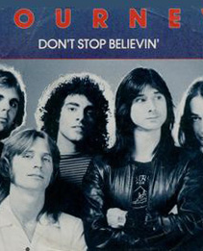
Answer
Don’t Stop Believin’
JOURNEY

Slide 29
Question-10
GENERAL KNOWLEDGE CLUE:
This Robbie Williams ballad is a staple at weddings, parties and karaoke nights.

Slide 30
Question-10
LYRIC CLUE:
"And through it all she offers me protection..."

Slide 31
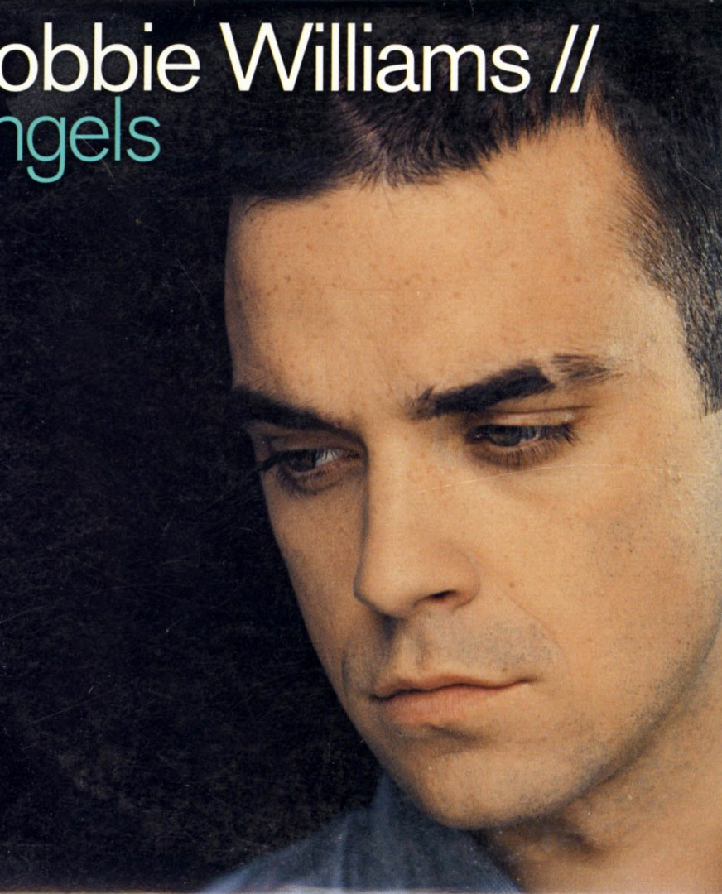
Answer
Angels
ROBBIE WILLIAMS

Slide 32
Score Check

Slide 33
QUIZ
PART-2

Slide 34
Question-11
GENERAL KNOWLEDGE CLUE:
This Spice Girls hit introduced the phrase "Girl Power" to the world.

Slide 35
Question-11
LYRIC CLUE:
"So tell me what you want, what you really really want..."

Slide 36
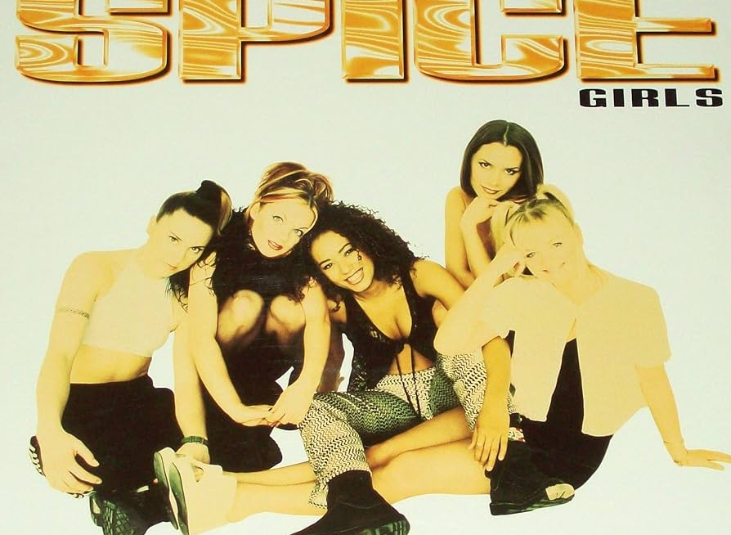
Answer
Wannabe
SPICE GIRLS

Slide 37
Question-12
GENERAL KNOWLEDGE CLUE:
This Whitney Houston classic was originally written and performed by another famous female icon.

Slide 38
Question-12
LYRIC CLUE:
“And so I’ll go, but I know, I’ll think of you …”

Slide 39
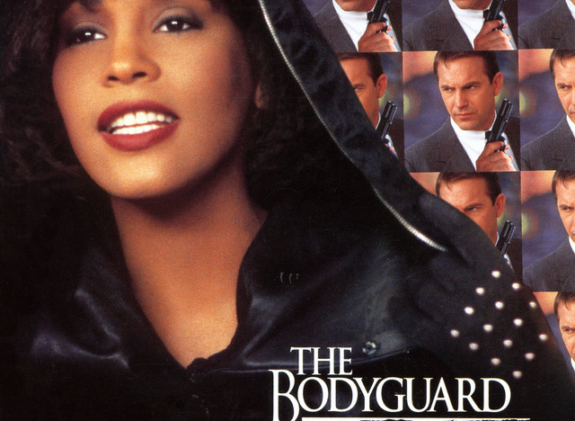
Answer
I Will Always Love You
WHITNEY HOUSTON / DOLLY PARTON

Slide 40
Question-13
GENERAL KNOWLEDGE CLUE:
This ABBA song became a musical, then a movie starring Meryl Streep.

Slide 41
Question-13
LYRIC CLUE:
“How can I resist you?”

Slide 42
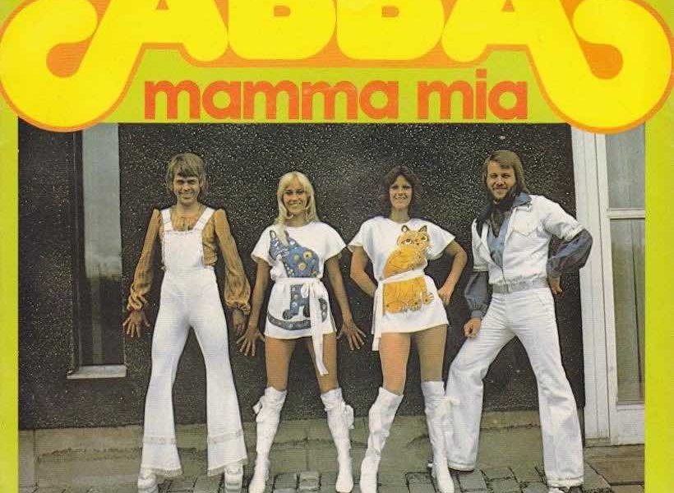
Answer
Mamma Mia
ABBA

Slide 43
Question-14
GENERAL KNOWLEDGE CLUE:
This duet from the recent film of A Star Is Born won an Oscar for Best Original Song.

Slide 44
Question-14
LYRIC CLUE:
"Tell me something, girl..."

Slide 45
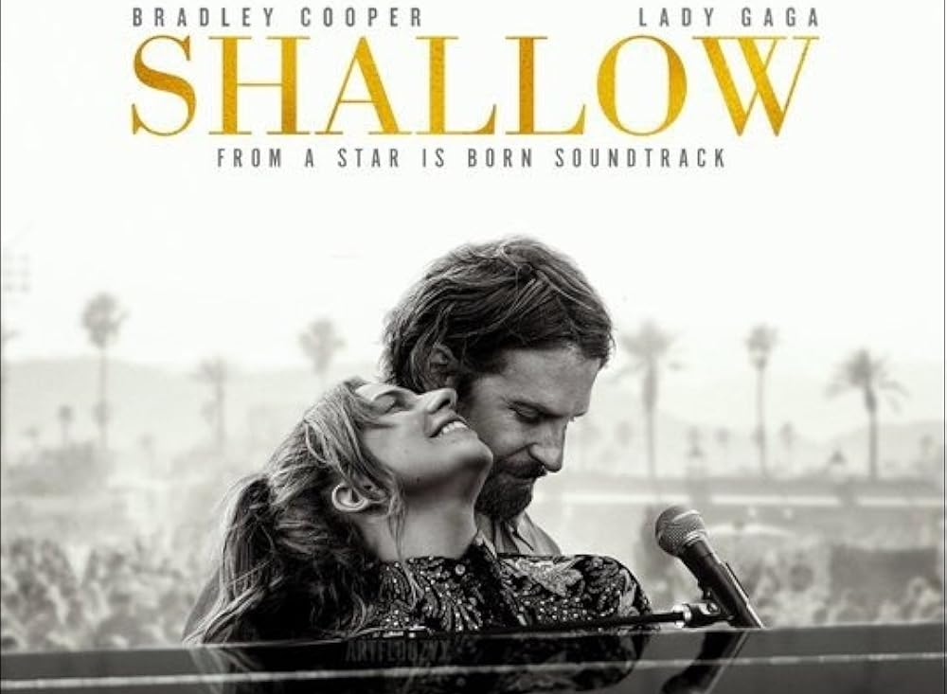
Answer
Shallow
Lady Gaga & Bradley Cooper

Slide 46
Question-15
GENERAL KNOWLEDGE CLUE:
This song is from one of the most successful Disney films ever made.

Slide 47
Question-15
LYRIC CLUE:
"The snow glows white on the mountain tonight..."

Slide 48

Answer
Let It Go
IDINA MENZEL

Slide 49
Question-16
GENERAL KNOWLEDGE CLUE:
This soundtrack song was originally showcased to the producers, with the writer using her fingernails as an instrument.

Slide 50
Question-16
LYRIC CLUE:
"Tumble out of bed and I stumble to the kitchen.”

Slide 51
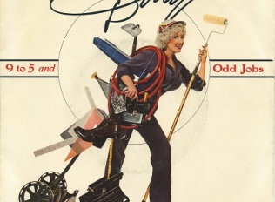
Answer
9-5
DOLLY PARTON

Slide 52
Question-17
GENERAL KNOWLEDGE CLUE:
This song is often sung as a duet between Danny and Sandy.

Slide 53
Question-17
LYRIC CLUE:
“I met a girl crazy for me.”

Slide 54
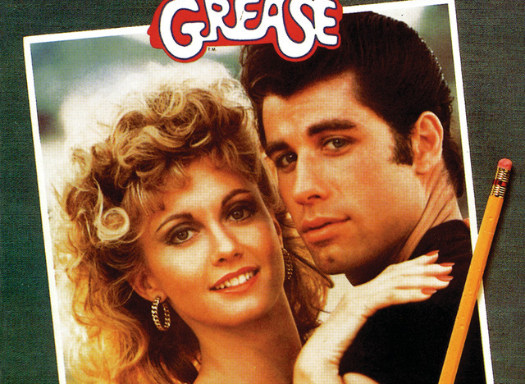
Answer
Summer Nights
GREASE

Slide 55
Question-18
GENERAL KNOWLEDGE CLUE:
Released in 2018, this hit by someone with the initials G.E. became a karaoke favourite surprisingly quickly.

Slide 56
Question-18
LYRIC CLUE:
“Homegrown alligator…”

Slide 57
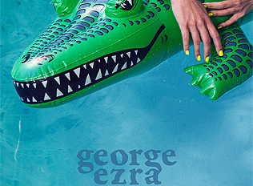
Answer
Shotgun
GEORGE EZRA

Slide 58
Question-19
GENERAL KNOWLEDGE CLUE:
This song's title is also the name of a famous London Train Station.

Slide 59
Question-19
LYRIC CLUE:
“The history book on the shelf is always repeating itself.”

Slide 60
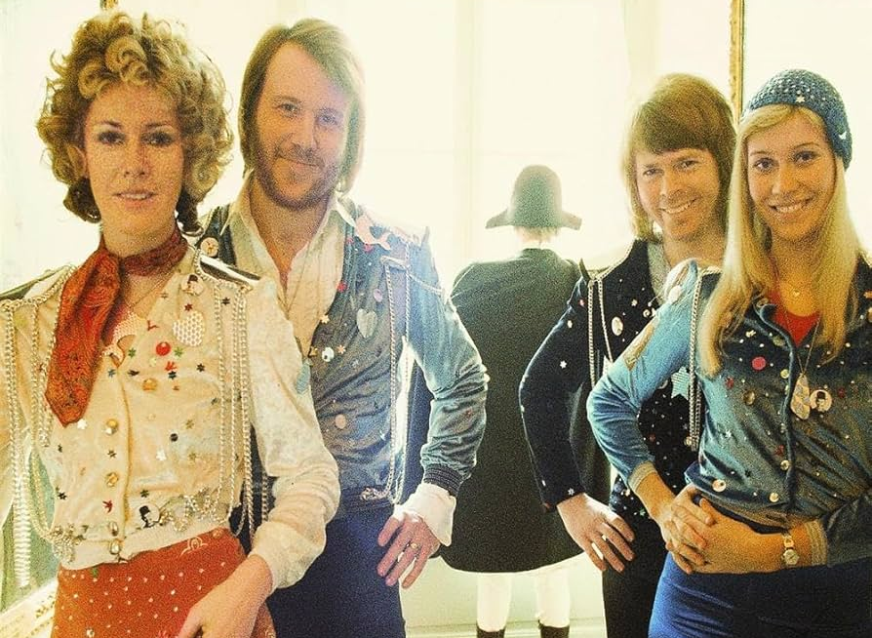
Answer
Waterloo
ABBA

Slide 61
Question-20
GENERAL KNOWLEDGE CLUE:
This song begins with one of the most recognisable opening lines in pop history.

Slide 62
Question-19
LYRIC CLUE:
"First I was afraid, I was petrified.”

Slide 63
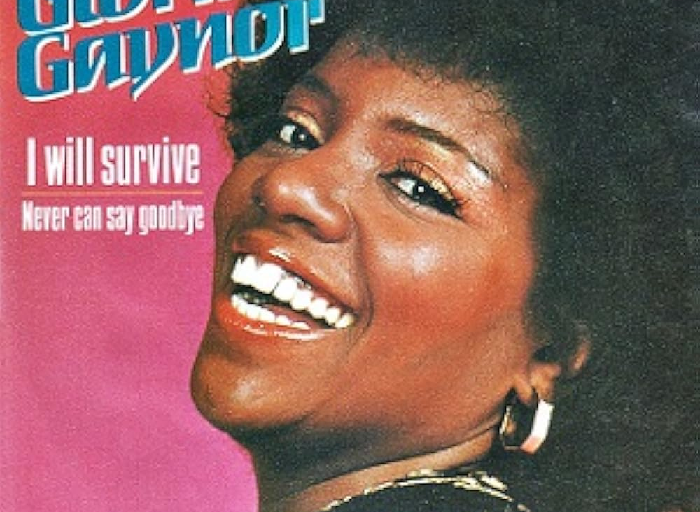
Answer
I Will Survive
GLORIA GAYNOR

Slide 64
Score Check

Slide 65
BONUS
QUESTIONS

Slide 66
Question-1
Which 2001 film features a famous karaoke performance of "I Will Survive" by a group of unlikely singers?
A) Love Actually
B) Bridget Jones's Diary
C) Shrek
D) Moulin Rouge!

Slide 67
Question-1
ANSWER:
C) Shrek

Slide 68
Question-2
In which country was karaoke invented?
A) South Korea
B) China
C) Japan
D) Thailand

Slide 69
Question-2
ANSWER:
C) Japan

Slide 70
Question-3
What does the Japanese word "kara" mean in the term karaoke?
A) Music
B) Empty
C) Voice
D) Microphone

Slide 71
Question-3
ANSWER:
B) Empty
Bonus Fact: "Kara" means empty and "oke" comes from orchestra, so the word "karaoke" roughly translates as "empty orchestra."

Slide 72
Question-4
Which of these karaoke favourites spent the longest time at No. 1 on the UK Singles Chart?
A) Angels
B) Dancing Queen
C) Bohemian Rhapsody
D) Wonderwall

Slide 73
Question-4
ANSWER:
C) Bohemian Rhapsody
Bonus Fact: It reached No. 1 twice in the UK—first in 1975 and again in 1991 after Freddie Mercury's death.

Slide 74
Question-5
What three-word phrase are UK karaoke audiences most likely to shout during Sweet Caroline?
A) "So good! So good! So good!"
B) "Sing it again!"
C) "Come on Neil!"
D) "One more time!"

Slide 75
Question-5
ANSWER:
A) So good! So good! So good!

Slide 76
How did you do?

